Slide 1
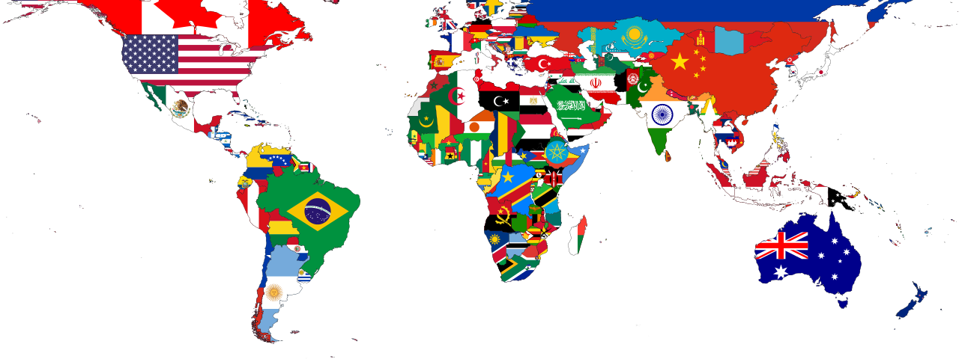
AngularJS
Internationalization & localization

Slide 2

What is internationalization?
Internationalization (i18n)
Planning and designing an app to support localization
Localization (l10n)
Adapting app to user’s specific local languages & culture
Do I need it?
Yes!
Even if you are only using one language, i18n helps keeping all your texts in one place

Slide 3
Angular-translate
Angular only provide translations for date, number & currency filters
The 3rd party library angular-translate is user by every angular app
https://angular-translate.github.io/
Created by Pascal Precht, Angular GDE

Slide 4
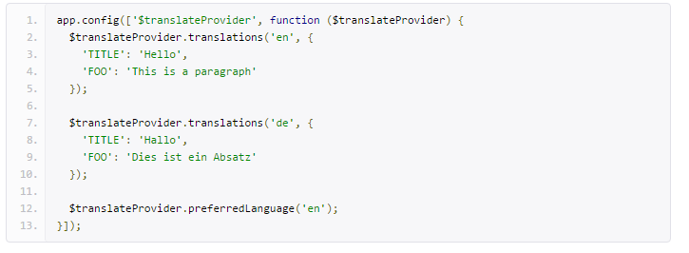
Setup angular-translate
Download lib & embed file in app
Inject module into your app
Add translations in the app configuration

Slide 5
Using angular-translate in html templates
Translate using the “translate” filter
Translate using “translate” the directive
The key can be dynamically assigned
Recommended

Slide 6


Using angular-translate in js
Translate using the “$translate” service
Calling the $translate service with the key as argument we can a promise to assign the translated text
The “instant” function return the translated text as a string
Recommended

Slide 7

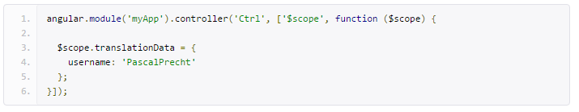
Variable replacement
Add variable in the translation file, between double brackets {{ }}
Use the variable with the filter
pass it as an argument to the filter

Slide 8
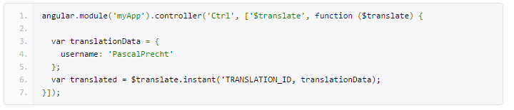
Variable replacement
Use a variable with the directive
Add the translate-values argument
Use variable with the service
Pass it as second argument in the instant function

Slide 9
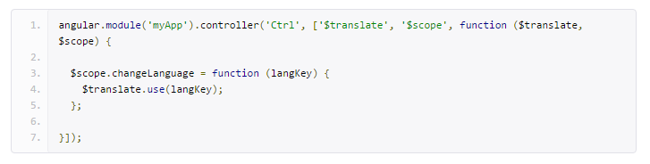
Setting language at runtime
Default is set in configuration
Call function “use” on $translate… that’s all!

Slide 10

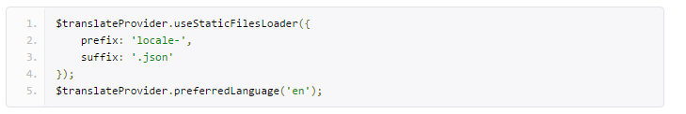
Loading translations from files
Create one json file per language, local-{{locale}}.json is the most common pattern :
locale-fr.json
locale-en.json
Install the static file loader sub module
https://github.com/angular-translate/bower-angular-translate-loader-static-files
Embed the file it in the HTML after angular-translate
Call the useStaticFilesLoader() in the configuration function

